Slide 1
The Parents’ Guide to
Google Classroom
Spanish Arabic
Notes:
Original Document credit Mr. Vacca from Mohonasen High School
https://www.youtube.com/watch?v=2Iowi-gmbys

Slide 2
What is
Google Classroom?
Think of Google Classroom (GC)
as your child’s digital link to learning.
Teachers use GC to share assignments, homework, newsletters, and much more with students AND parents!

Slide 3
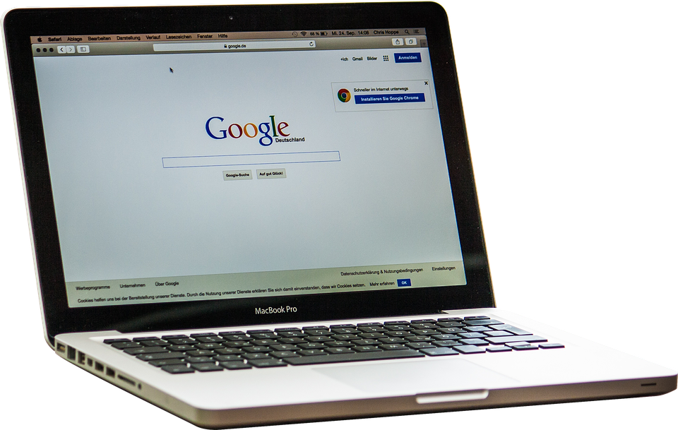
Getting Started
Your child was provided with a secure login and password that is unique to them.
Check with his/her teacher to obtain this private information OR ask them to add you as a parent via email!

Slide 4
Getting Started
Click on the Google Chrome browser icon.

Slide 5
Getting Started
Type www.google.com into your web
address bar.

Slide 6
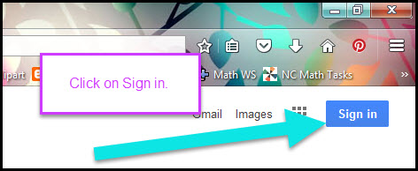
Getting Started
Click on SIGN IN in the upper right hand corner of the browser window.

Slide 7
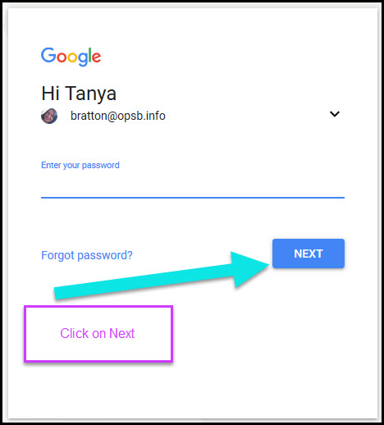
Getting Started
Type in your child’s Google Email address
(studentid@csdnbstudents.org) & click “next.”

Slide 8
Getting Started
Type in your PASSWORD
& click “next.”

Slide 9
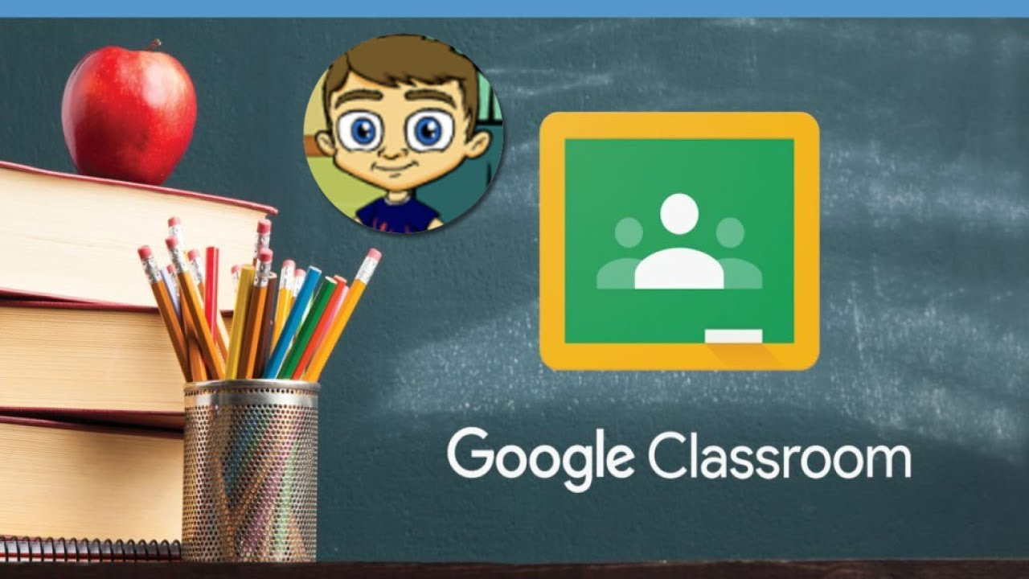
Click on the picture for explanatory video
Please ask your child to log onto GC with his NCC log in and show you all his classes. CLICK ON THE PICTURE
Access Live Lesson

Slide 10
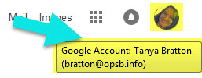
Now you’ll see
that you are signed in to your Google Apps for Education account!
Google Account email:
studentid@csdnbstudents.org

Slide 11
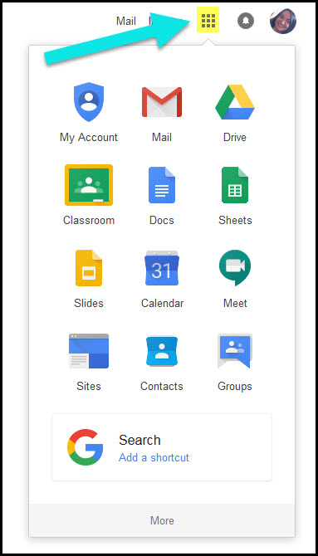
Google
suite
Click on the 9 squares
(Waffle/Rubik’s Cube) icon in the
top right hand corner to see
the Google Suite of Products!

Slide 12
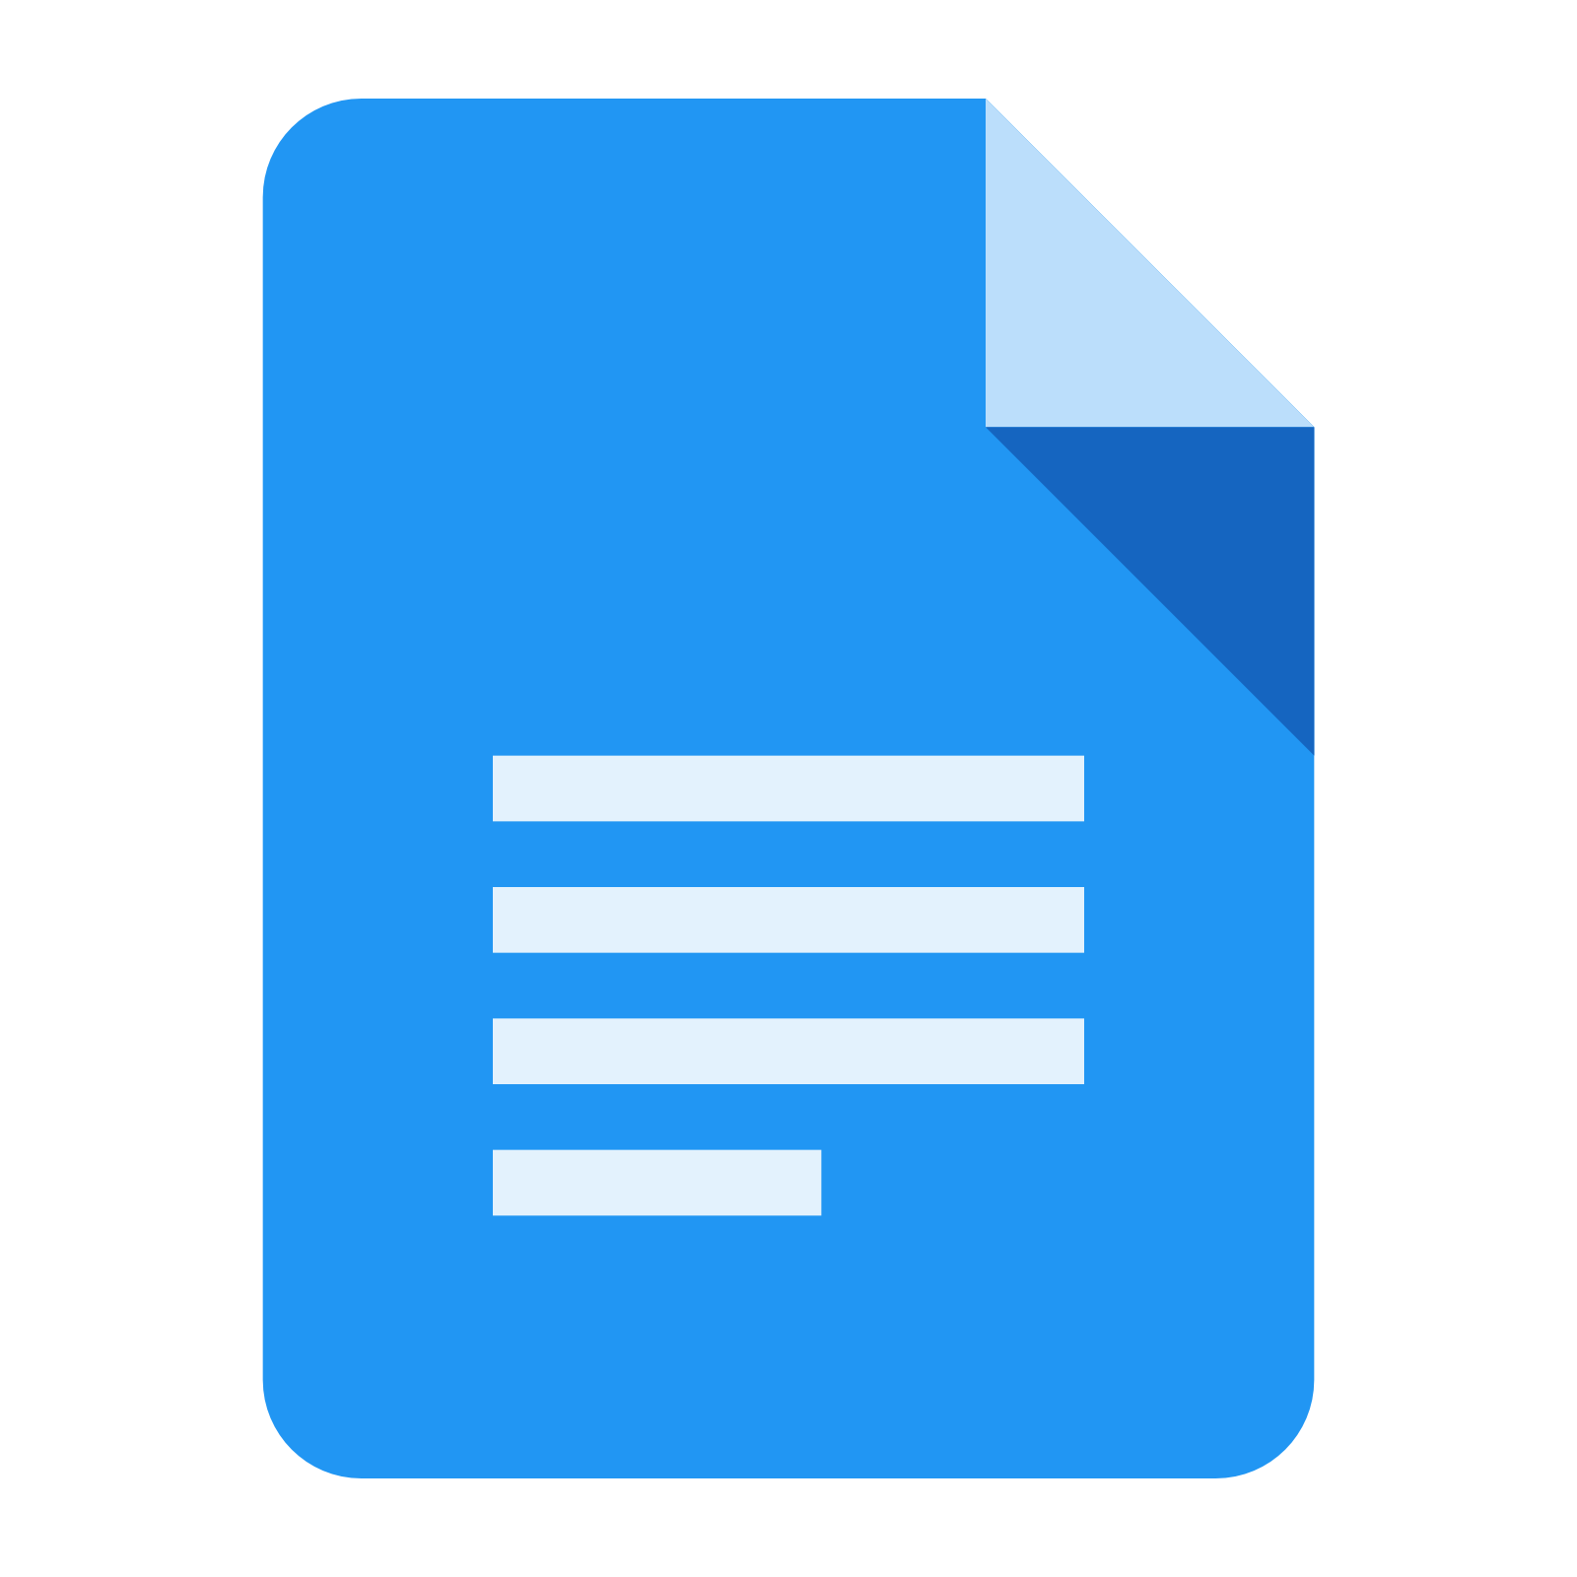
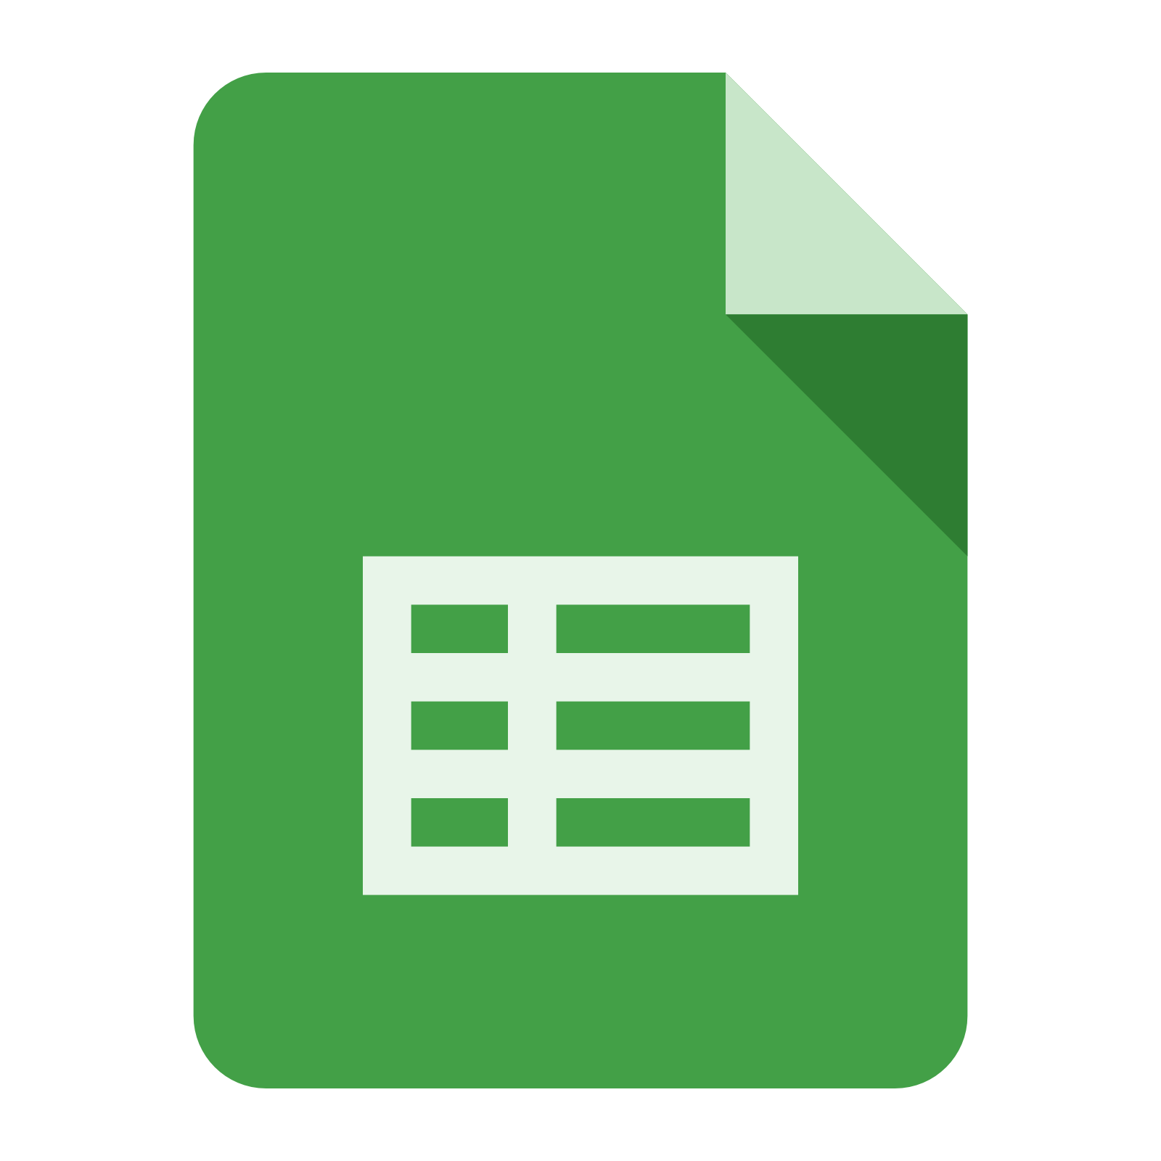
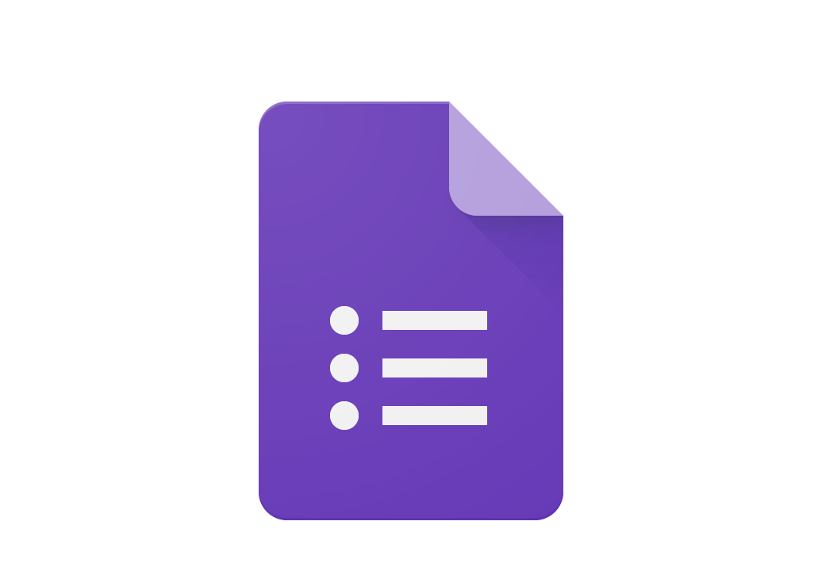
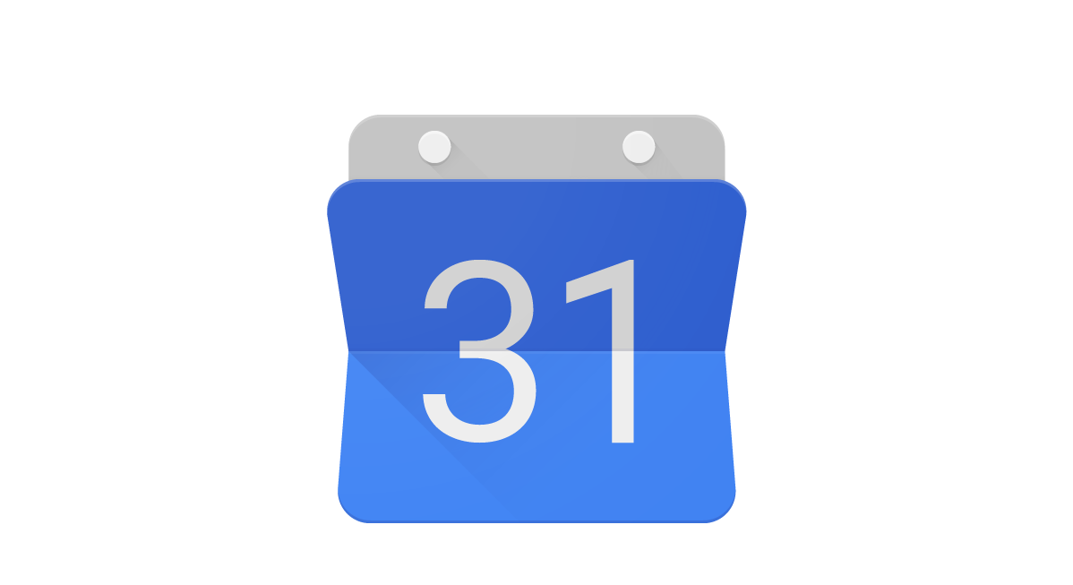
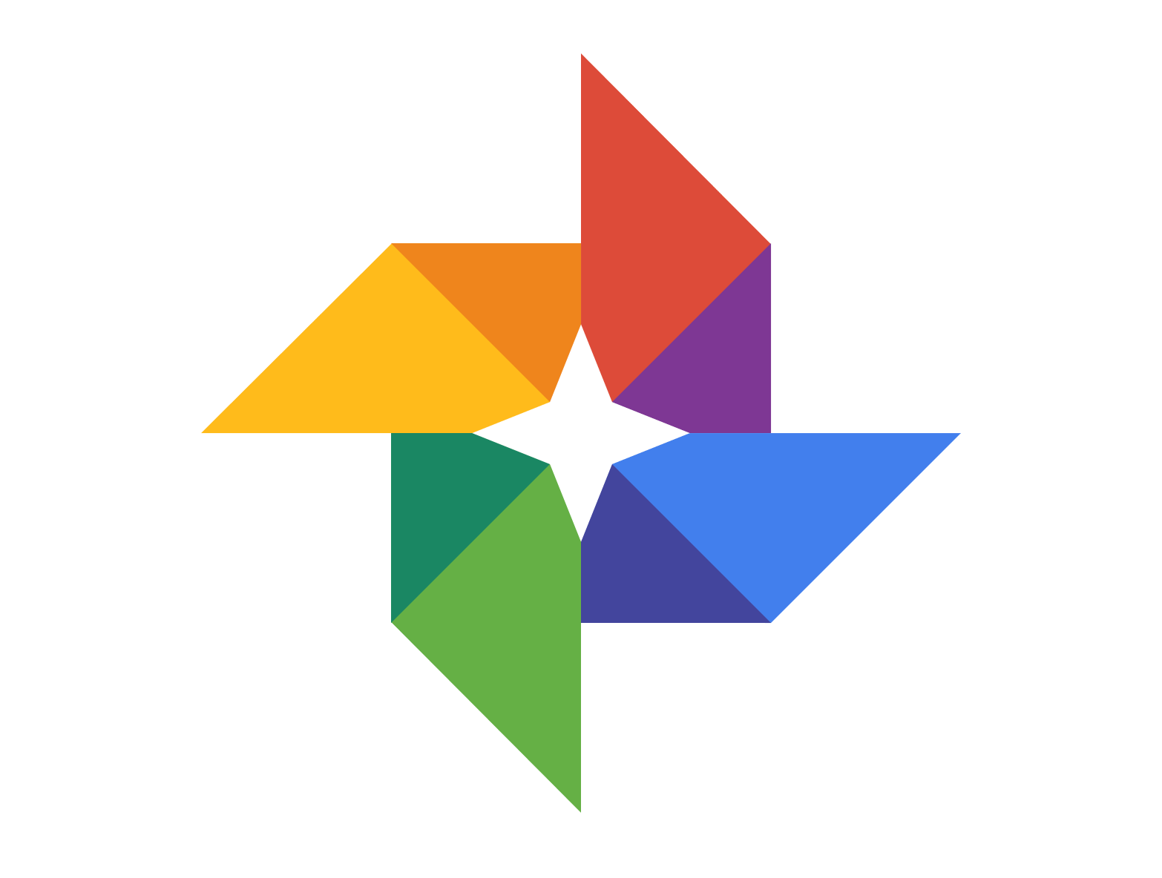
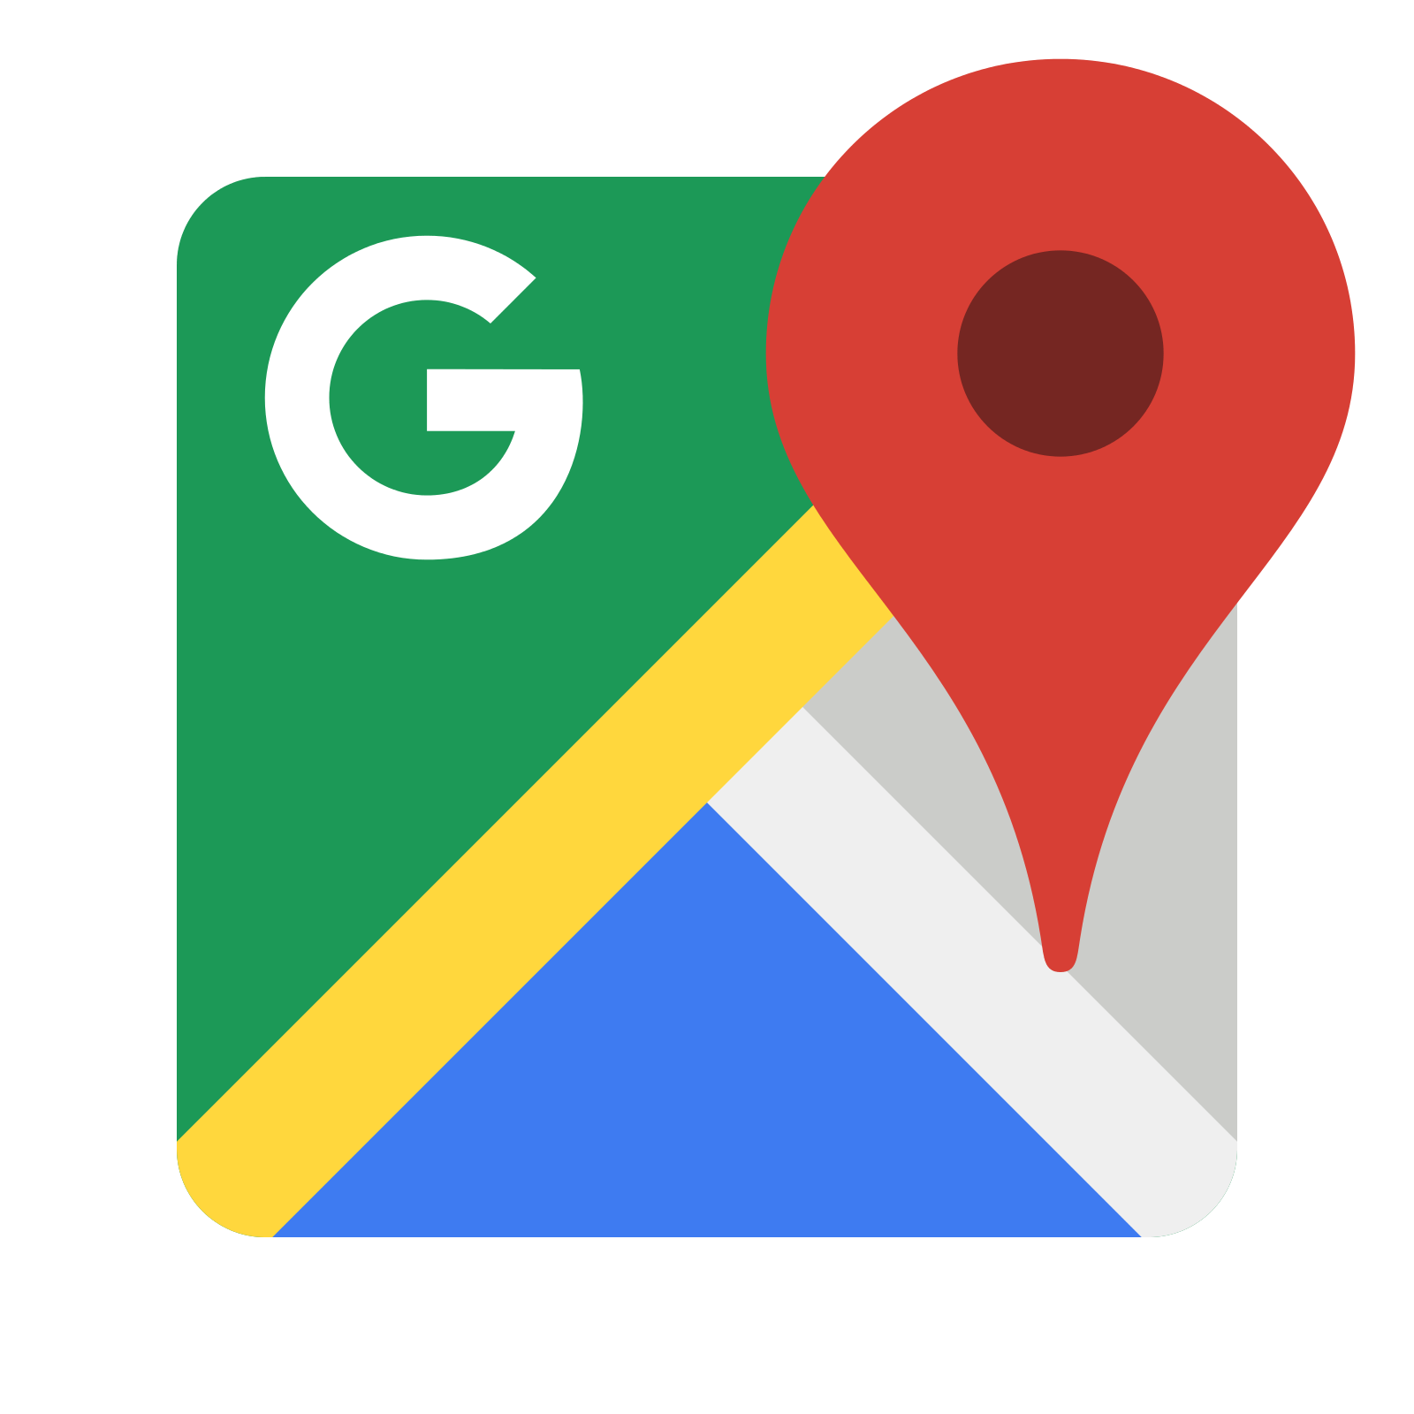
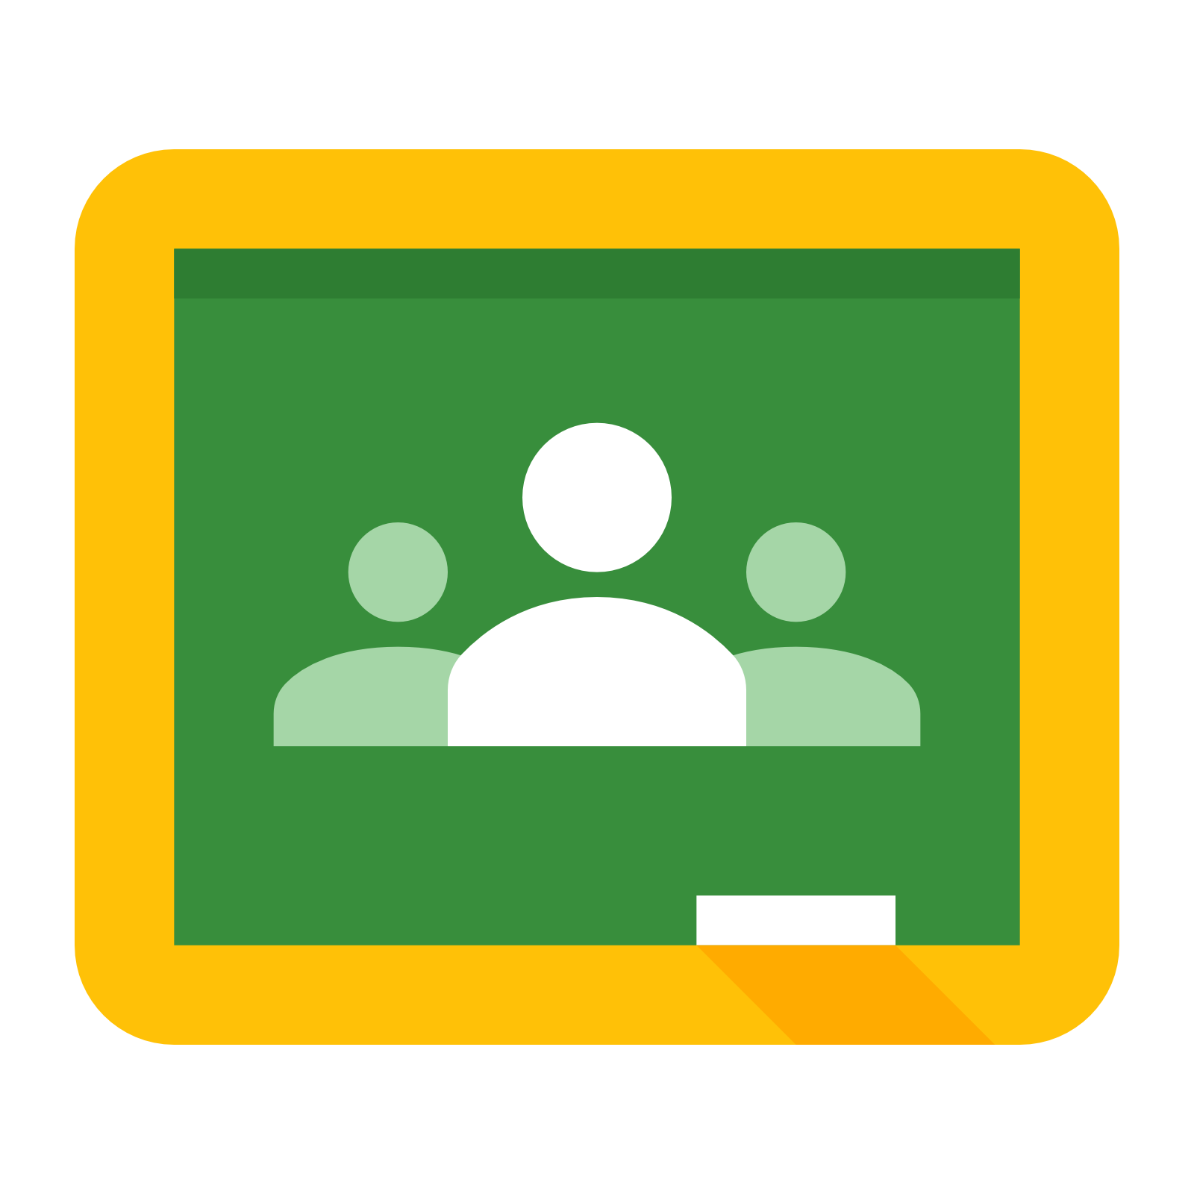
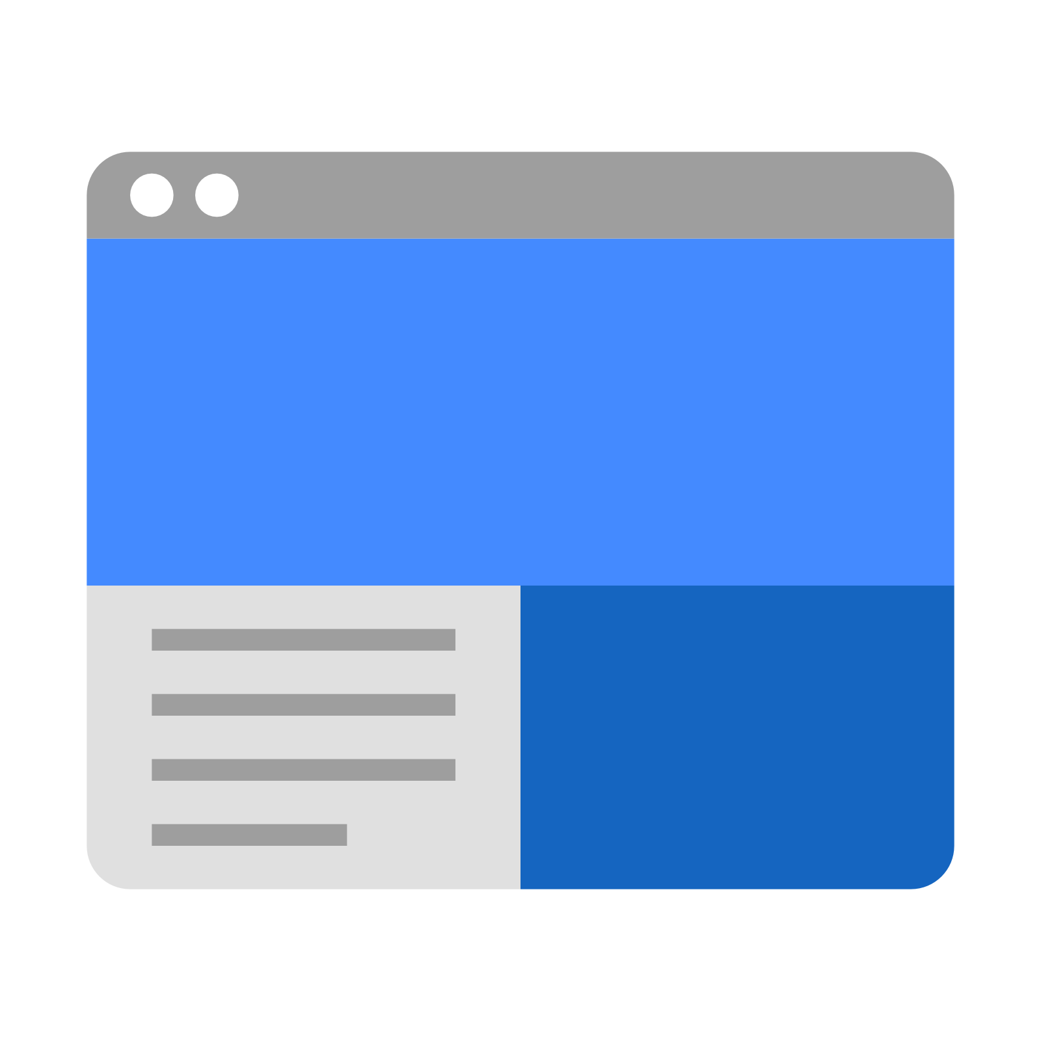
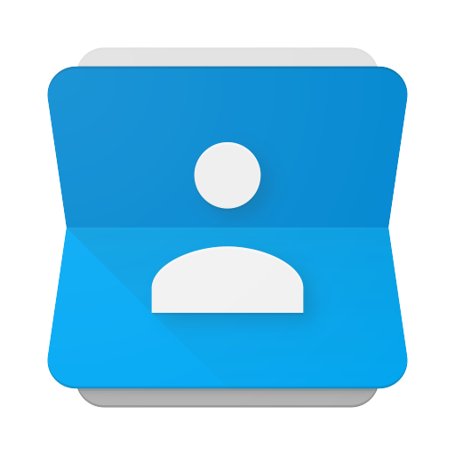
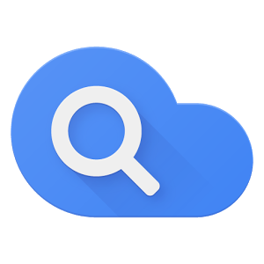
GOOGLE ICONS to recognize:
CHROME DOCS DRIVE SLIDES SHEETS FORMS CALENDAR
GMAIL PHOTOS MAPS KEEP CLASSROOM MEET HANGOUTS
SITES CONTACTS CLOUD CLOUD SEARCH YOUTUBE NEWS VAULT
MY ACCOUNT GROUPS

Slide 13
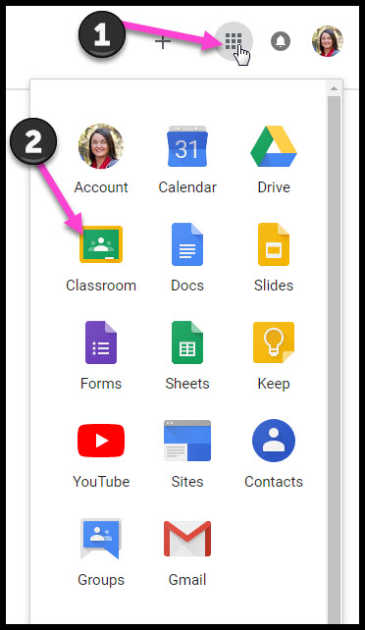
Navigating Classroom
Click on the waffle button and then the
Google Classroom icon.

Slide 14
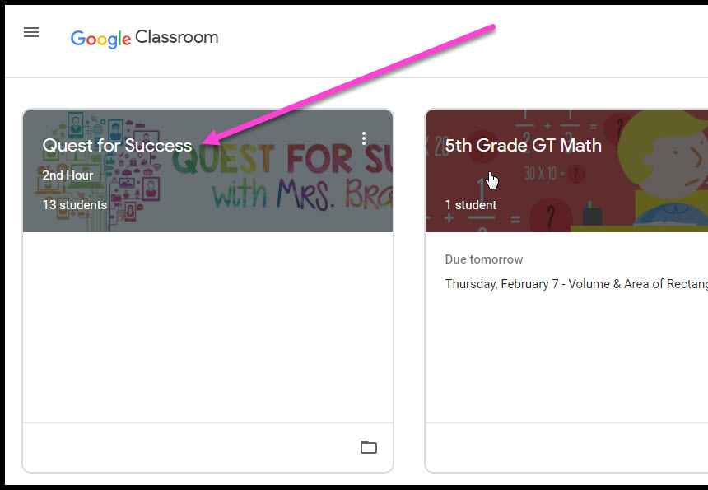
Navigating Classroom
Click on the class you wish to view.

Slide 15
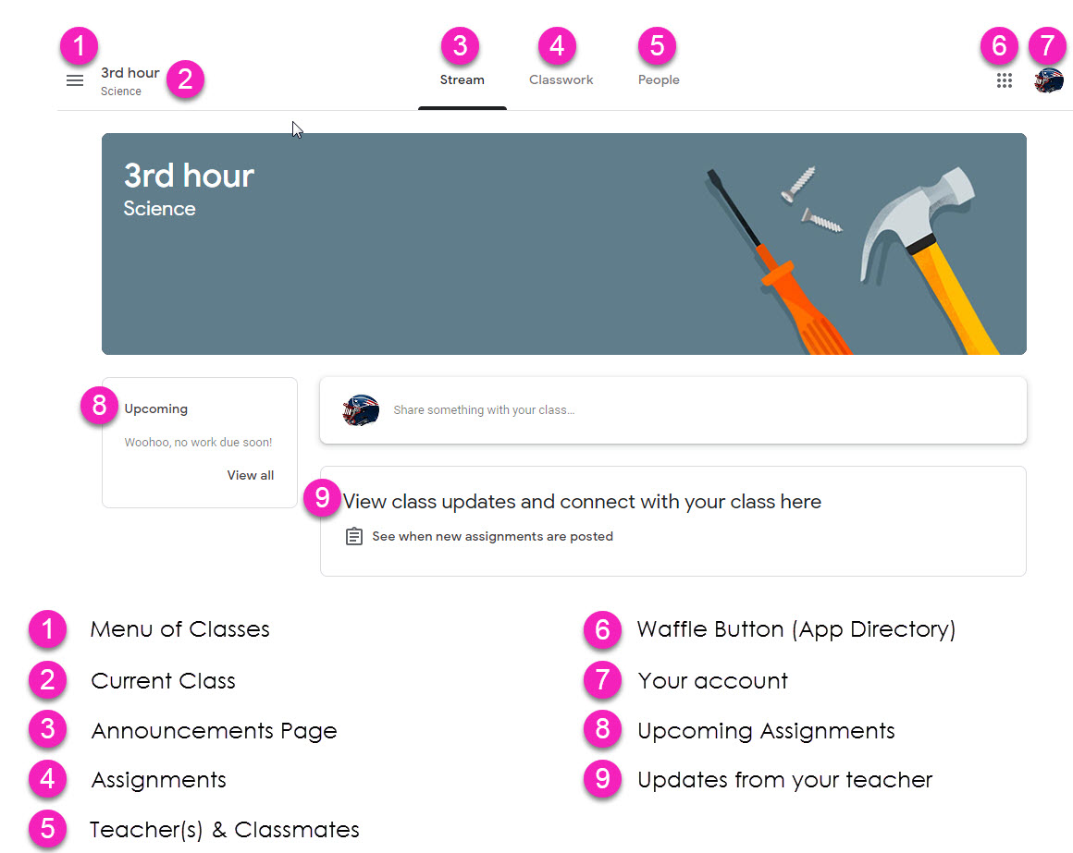
Navigating Classroom
= High Interest for Parents
Page tools
(Left side)

Slide 16
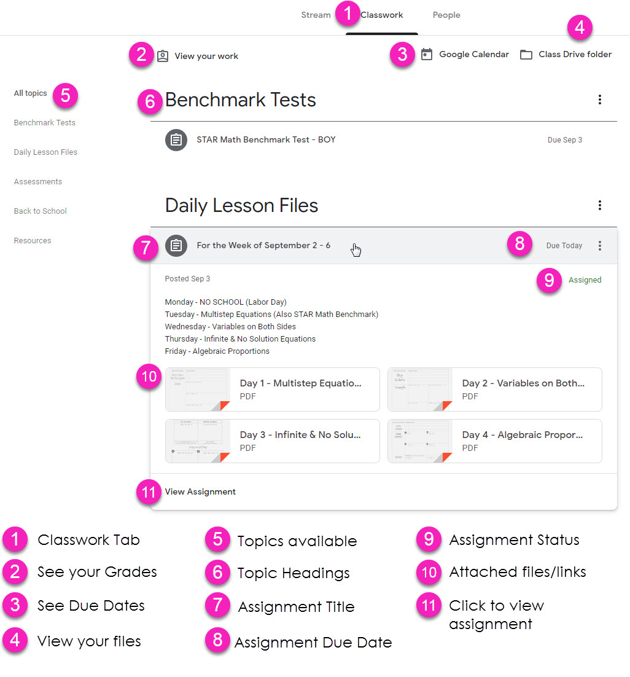
Navigating Classroom
Assignment details

Slide 17
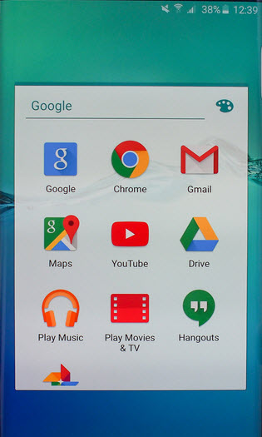
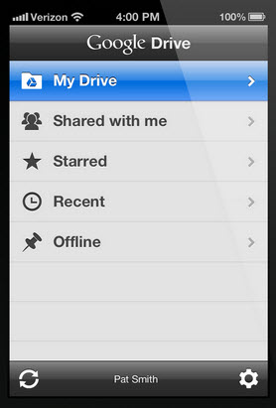
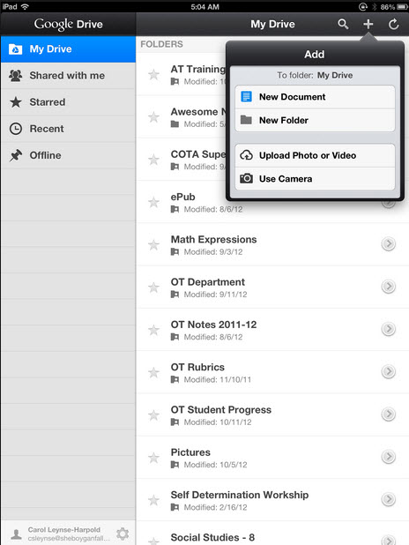
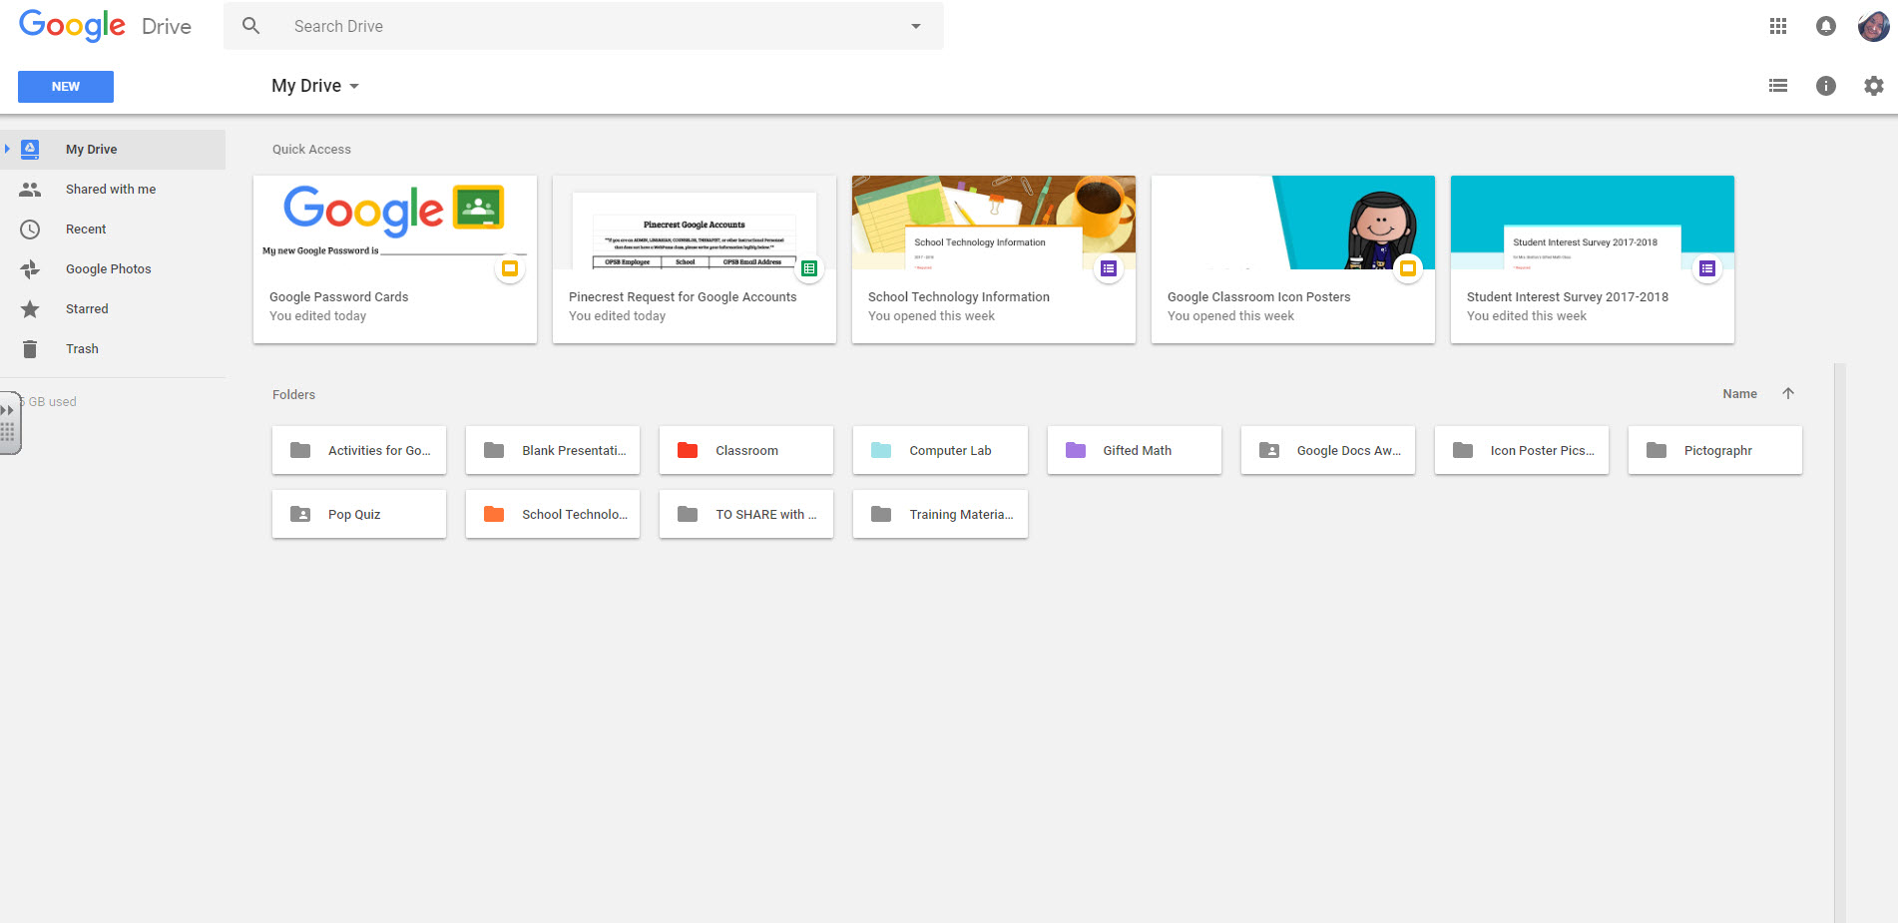
access
anywhere
Android
Iphone
Tablet
desktop

Slide 18
GOOGLE APPS
allow you to edit Google assignments from
any device that is connected to the internet!

Slide 19
questions?
Email us at: parenthelp@csdnb.org

